Slide 1


Car Plate Recognition and Reconstruction with DeepLearning
Computer Vision
Prof.ssa Irene Amerini
A.A. 2024/2025
Luca Conti, 1702084
Kevin Giannandrea, 2202212
Mattia Tarantino, 1933469
Tutti i diritti relativi al presente materiale didattico ed al suo contenuto sono riservati a Sapienza e ai suoi autori (o docenti che lo hanno prodotto). È consentito l'uso personale dello stesso da parte dello studente a fini di studio. Ne è vietata nel modo più assoluto la diffusione, duplicazione, cessione, trasmissione, distribuzione a terzi o al pubblico pena le sanzioni applicabili per legge
Notes:
DIMINUISCI LA GRANDEZZA DEL TESTO DELLE NOTE!!

Slide 2
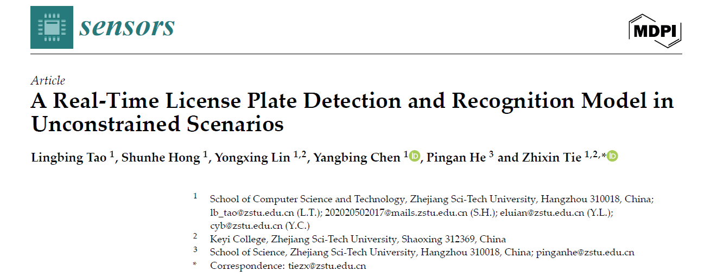
Introduction
Goal:
Design and implement a two-stage pipeline for license plate (LP) detection and recognition, following the methodology outlined by Tao et al. (2024)
First stage: YOLOv5 for LP detection
Second stage: PDLPR for LP recognition
Car Plate Recognition and Reconstruction with DeepLearning

Slide 3
Introduction
Goal:
Implement a simple baseline, train and evaluate it with the metrics used by Tao et al. (2024)
Compare the performance of the proposed model with the baseline
Car Plate Recognition and Reconstruction with DeepLearning

Slide 4
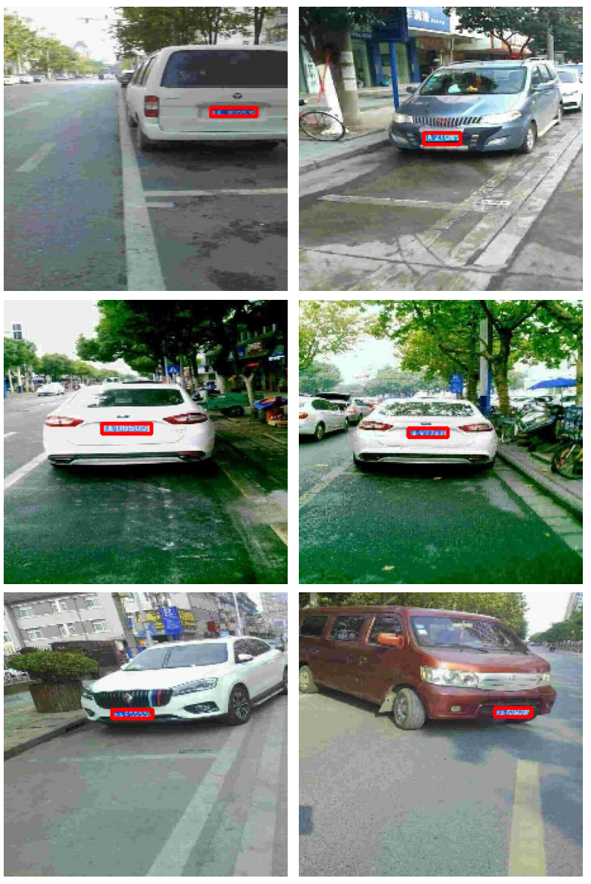
Dataset
CCPD (Chinese City Parking Dataset) is a large open-source dataset of Chinese license plates.
Sub-Dataset | Description
CCPD-Base | The only common feature of these photos is the inclusion of a LP.
CCPD-DB | Dark, uneven, or extremely bright illumination in the LP area.
CCPD-FN | Captured from varying distances
CCPD-Rotate | Large horizontal tilt and vertical tilt.
CCPD-Tilt | Extreme horizontal and vertical tilt.
CCPD-Blur | Blurry images, mostly due to hand jitter during capture.
CCPD-Weather | Images taken in adverse weather: rain, snow, or fog.
CCPD-Challenge | The most difficult and complex images for license plate detection and recognition (LPDR).
Car Plate Recognition and Reconstruction with DeepLearning

Slide 5
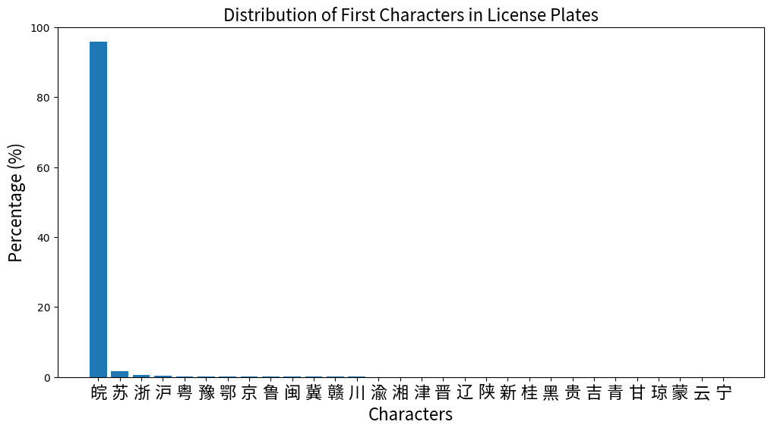
Dataset
The distribution of Chinese characters in the CCPD dataset is highly imbalanced, with the character 皖 (Anhui) appearing in approximately 95% of the samples.
Car Plate Recognition and Reconstruction with DeepLearning

Slide 6
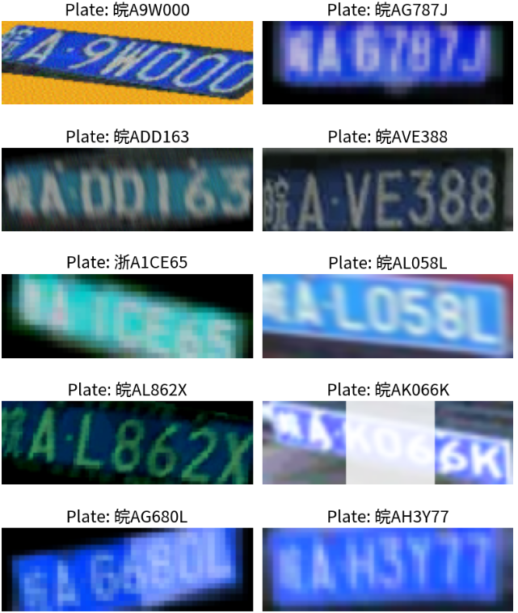
Data Augmentation
To improve generalization and to prevent overfitting, we employed data augmentation:
Affine transformations:
(rotation, shear, translations, scale)
Blur
Color dithering
Change in:
(contrast, saturation, brighteness)
Image quality degradation
Other visual pertubations
Car Plate Recognition and Reconstruction with DeepLearning

Slide 7
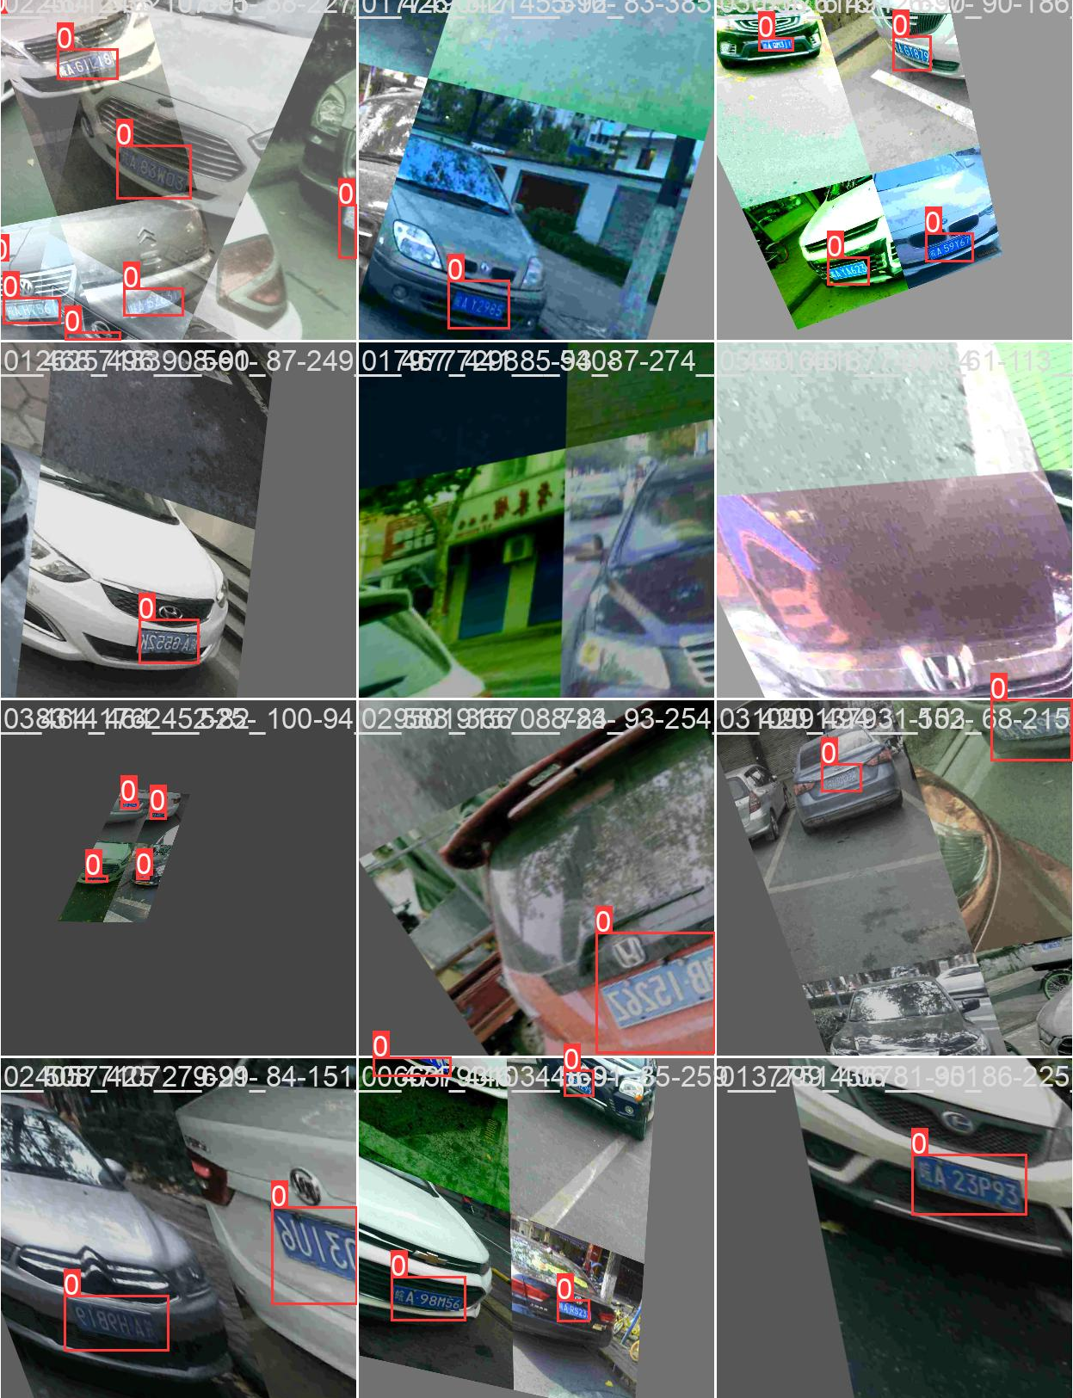
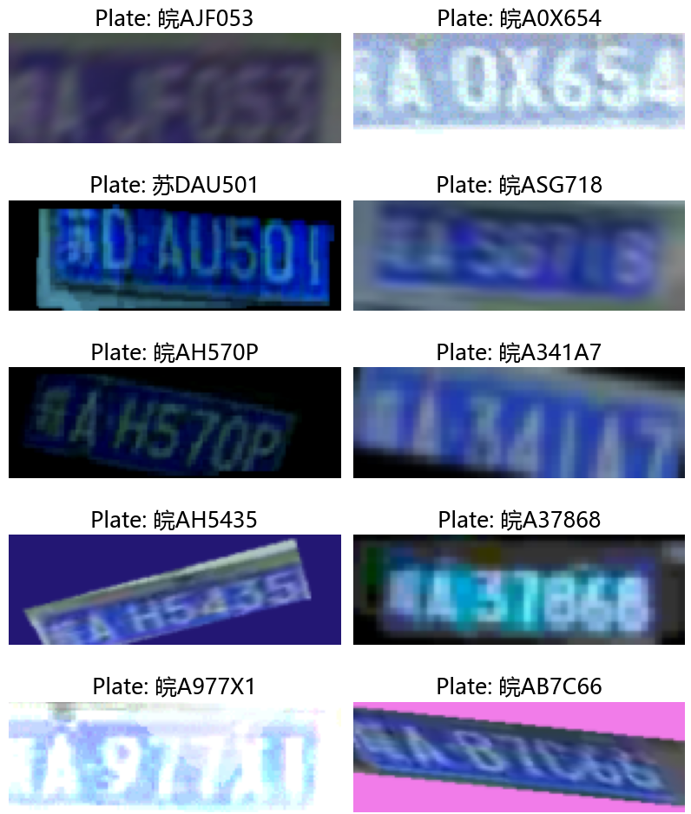
Data Augmentation
Detection (YOLOv5)
Recognition
Car Plate Recognition and Reconstruction with DeepLearning

Slide 8
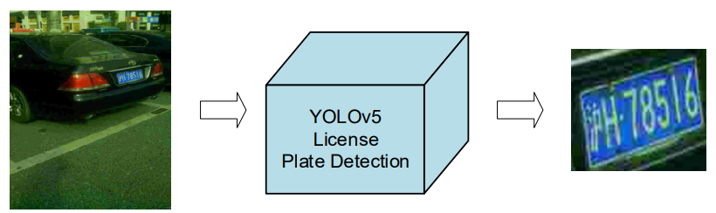
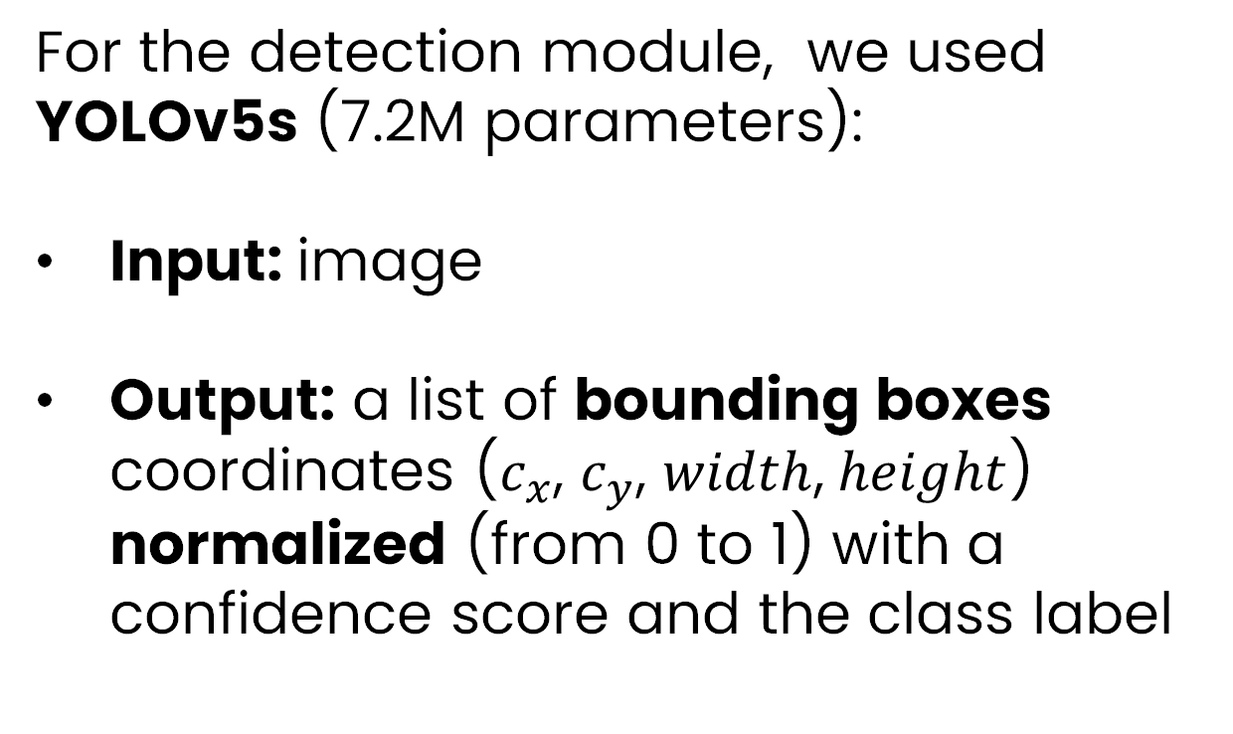
YOLOv5
For the detection module, we used YOLOv5s (7.2M parameters):
Input: image
Output: a list of bounding boxes coordinates ($c_{x}$, $c_{y}$, $width$,$height$) normalized (from 0 to 1) with a confidence score and the class label
Id | c_x | c_y | width | height | confidence
0 | 0.47326 | 0.36937 | 0.38143 | 0.06616 | 0.83943
0 | 0.47204 | 0.36831 | 0.37532 | 0.06425 | 0.87525
0 | 0.47276 | 0.36876 | 0.37554 | 0.06505 | 0.87570
An example of YOLOv5 output
Car Plate Recognition and Reconstruction with DeepLearning

Slide 9
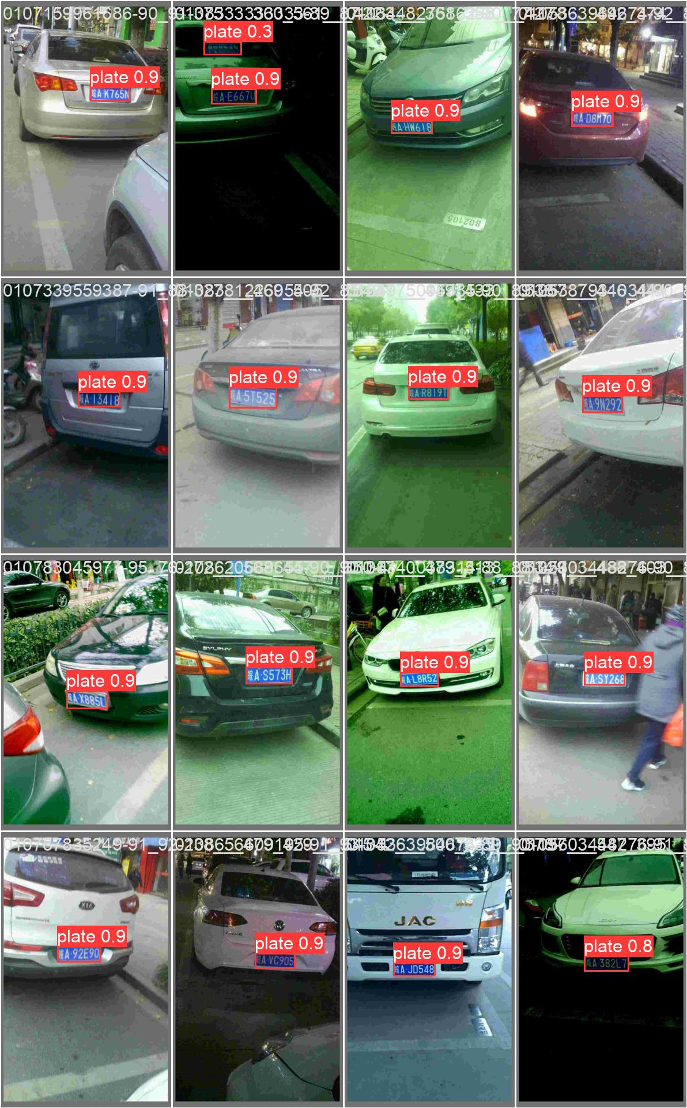
YOLOv5
Car Plate Recognition and Reconstruction with DeepLearning

Slide 10
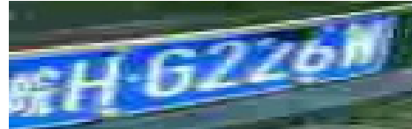
PDLPR: overall structure
Improved Global Feature Extractor (IGFE)
Extracts features and converts them into a feature vector
Encoder Module
Encode the vector using MHA to produce a feature vector.
Decoder Module
Utilizes Multi-Head Attention to decode the encoder's output feature vector.
Predicts the final license plate sequence
3, 48, 144
IGFE
512, 3, 18
Encoder
512, 3, 18
Parallel Decoder
皖HG226W
Car Plate Recognition and Reconstruction with DeepLearning

Slide 11
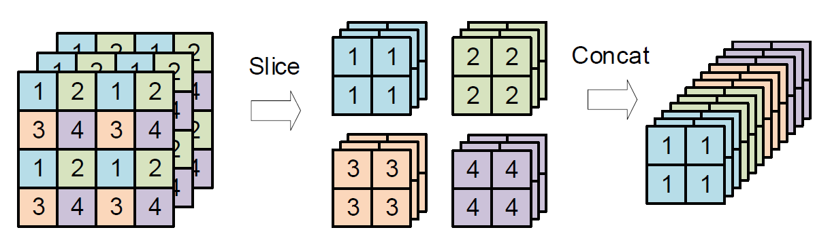
PDLPR: IGFE
ConvDownSampling
SiLU
Feature Extractor
GroupNorm
ConvDownSampling
Conv2D 3x3
Stride=2
RESBLOCK
CNN BLOCK
RESBLOCK
+
SiLU
RESBLOCK
CNN BLOCK
GroupNorm
ConvDownSampling
Conv2D 3x3
Stride=1
CNN BLOCK
RESBLOCK
RESBLOCK
FocusStructure
Car Plate Recognition and Reconstruction with DeepLearning

Slide 12
PDLPR: Encoder
Input : [512, 3, 18]
Positional encoding 2D
3x Encoder Unit:
CNN BLOCK1
MHA
CNN BLOCK2
Add&Norm
Output : [512, 3, 18]
Add&Norm
CNN BLOCK2
Encoding
Unit x3
Multihead Attention
CNN BLOCK1
+
Positional encoding 2D
IGFE
Output
Car Plate Recognition and Reconstruction with DeepLearning

Slide 13
PDLPR: Parallel decoder
CNN BLOCK6
Input : [512, 3, 18]
Positional Encoding 2D
3x Decoding unit:
No masked MHA (not autoregressive)
Add&Norm
MH Cross-Attention
Add&Norm
FFN
Add&Norm
CNN BLOCK5
CNN BLOCK6
Output: [512, 18, 68]
CNN BLOCK5
Add&Norm
FFN
Decoding
Unit x3
Add&Norm
Encoder Output
CNN BLOCK3
Multihead Attention
CNN BLOCK4
Add&Norm
Multihead Attention
+
Positional encoding 2D
Car Plate Recognition and Reconstruction with DeepLearning

Slide 14
Baseline: Detection
Architecture Overview
Backbone:
ResNet-18 (pre-trained on ImageNet)
Feature Fusion:
Feature Pyramid Network (FPN)
Combines features from layer3 and layer4
Uses 1×1 conv + upsampling + element-wise addition
Head:
Global Average Pooling (GAP)
MLP with one hidden layer (dropout+ReLU)
Sigmoid
Output: (cx,cy,w,h)∈[0,1]
(cx,cy,w,h)
Sigmoid
Box regressor (MLP)
AdaptiveAvgPool2d
FPN+Upsampling
layer4
Conv1x1
layer3
ResNet-Backbone
Stem(backbone[:6])
Car Plate Recognition and Reconstruction with DeepLearning

Slide 15
Baseline: Recognition
Input: image [3, 48, 144]
1. Feature extractor:
Convolutional backbone to extract spatial features:
with increasing channel dimensions
2. Sequence Modeling:
2-layer Bidirectional LSTM
Input sequence length: 36 (from image width)
Feature vector per step: 256 × 12 = 3072
Output: 7×1024 (per image)
3. Head:
Linear projection of 1024 → 68 class logits
Output: [7, 68]
FFN
Bidirectional
LSTM
CNN BLOCK4 (d=256)
CNN BLOCK3 (d=256)
Max Pooling 2x2
CNN BLOCK
CNN BLOCK2 (d=128)
ReLU
Max Pooling 2x2
BatchNorm.
CNN BLOCK1
(d=64)
Conv2D 3x3
padding=1
Car Plate Recognition and Reconstruction with DeepLearning

Slide 16
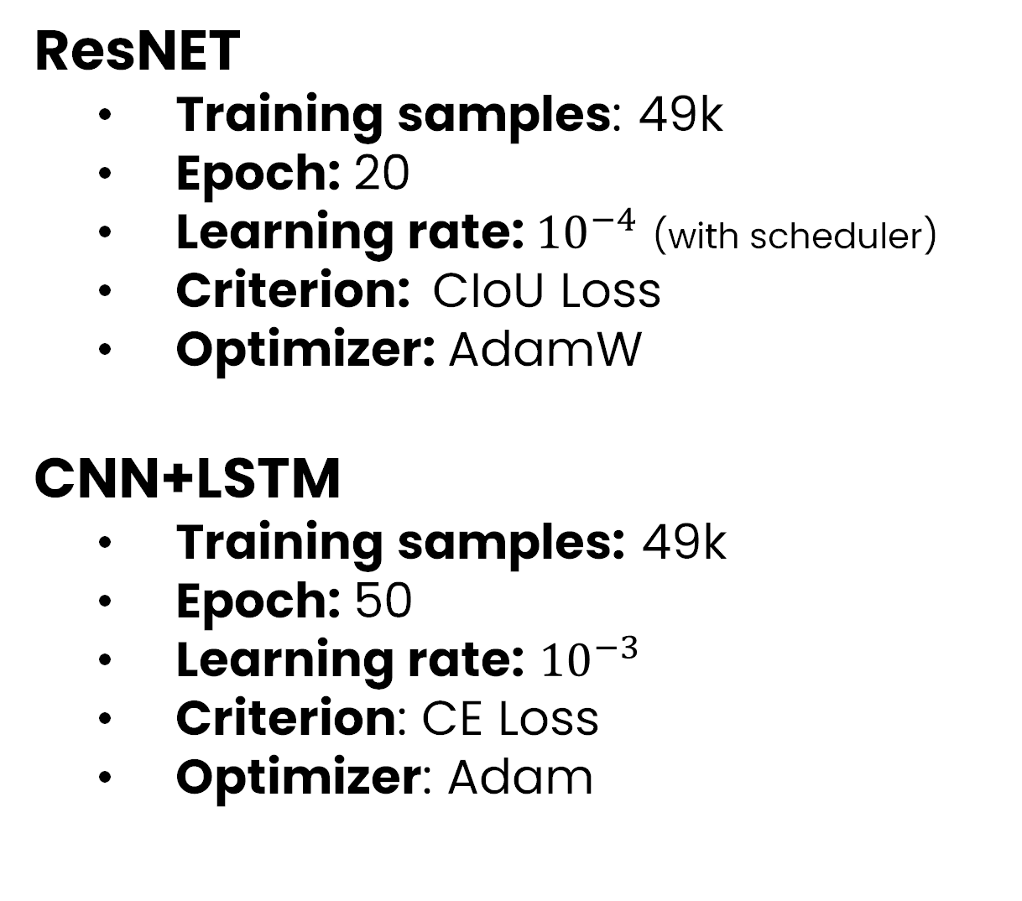
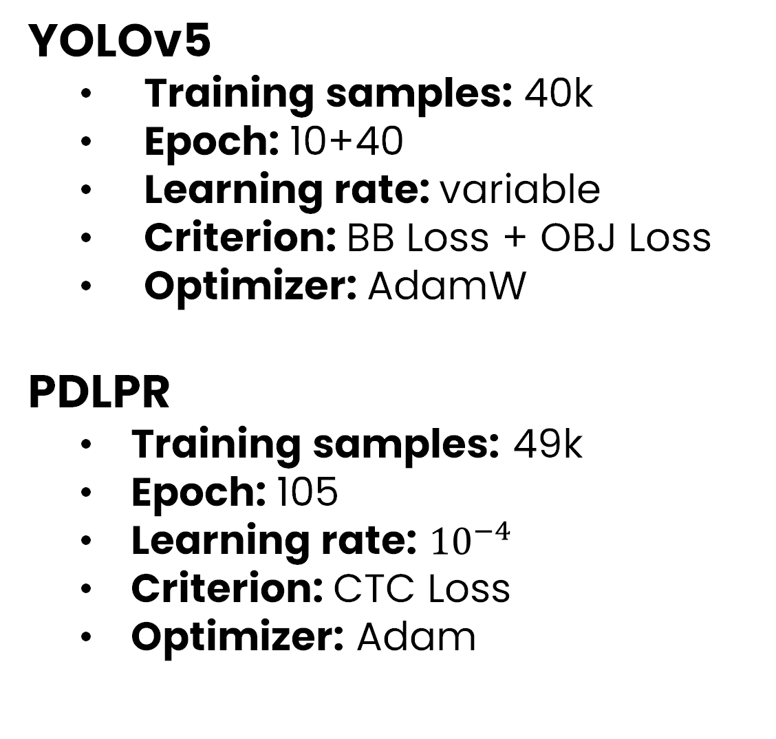
Training Phase
YOLOv5 + PDLPR
Baseline
YOLOv5
Training samples: 40k
Epoch: 10+40
Learning rate: variable
Criterion: BB Loss + OBJ Loss
Optimizer: AdamW
PDLPR
Training samples: 49k
Epoch: 105
Learning rate: ${10}^{−4}$
Criterion: CTC Loss
Optimizer: Adam
ResNET
Training samples: 49k
Epoch: 20
Learning rate: ${10}^{−4}$ (with scheduler)
Criterion: CIoU Loss
Optimizer: AdamW
CNN+LSTM
Training samples: 49k
Epoch: 50
Learning rate: ${10}^{−3}$
Criterion: CE Loss
Optimizer: Adam
Car Plate Recognition and Reconstruction with DeepLearning

Slide 17
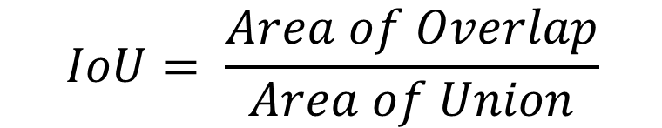
Evaluation metrics
Intersection over Union (IoU) : the amount of overlapping area between two bounding boxes over the total area covered by both boxes
$$IoU= \frac{Area of Overlap}{Area of Union}$$
Sequence Accuracy : measures the percentage of license plates where the entire predicted sequence exactly matches the ground truth
$$Sequence Accuracy= \frac{number of correctly predicted license plate}{total number of license plate}$$
Car Plate Recognition and Reconstruction with DeepLearning

Slide 18
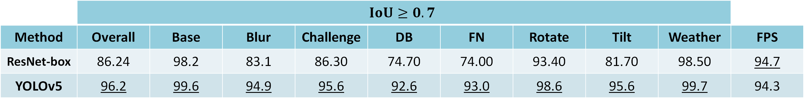
Results: Detection
*Each subset has 1k samples
 | $$IoU≥0.7$$
Method | Overall | Base | Blur | Challenge | DB | FN | Rotate | Tilt | Weather | FPS
ResNet-box | 86.24 | 98.2 | 83.1 | 86.30 | 74.70 | 74.00 | 93.40 | 81.70 | 98.50 | 94.7
YOLOv5 | 96.2 | 99.6 | 94.9 | 95.6 | 92.6 | 93.0 | 98.6 | 95.6 | 99.7 | 94.3
YOLOv5:
Achieves significantly higher overall accuracy
Shows strong generalization across all subsets
ResNet-box:
Slightly faster
Struggles more in challenging scenarios
Car Plate Recognition and Reconstruction with DeepLearning

Slide 19
Results: Recognition
*Each subset has 1k samples
 | Sequence Accuracy
Method | Overall | Base | Blur | Challenge | DB | FN | Rotate | Tilt | Weather | FPS
CNN+LSTM | 89.9 | 99.6 | 84.3 | 85.6 | 83.4 | 86.4 | 93.9 | 87.0 | 99.0 | 552.65
PDLPR | 91.85 | 99.8 | 90.6 | 89.6 | 84.7 | 90.5 | 93.9 | 86.9 | 98.8 | 311.49
PDLPR:
Achieves higher overall sequence accuracy
Stronger performance on challenging subsets
CNN+LSTM:
Much higher speed
Sightly less accurate
Car Plate Recognition and Reconstruction with DeepLearning

Slide 20
Results: Detection + Recognition
*Each subset has 1k samples
 | Sequence accuracy (IoU>0.6)
Method | Overall | Base | Blur | Challenge | DB | FN | Rotate | Tilt | Weather | FPS
Baseline | 86.86 | 99.7 | 77.7 | 82.6 | 76.4 | 80.0 | 93.3 | 86.5 | 98.7 | 85.96
YOLOv5-PDLPR | 89.49 | 99.7 | 81.9 | 88.9 | 74.6 | 88.7 | 94.0 | 89.4 | 98.7 | 66.17
YOLOv5-PDLPR:
Achieves higher overall accuracy
Outperforms the baseline on challenging subsets
Baseline (ResNet18 + BiLSTM)
Remains competitive, especially on CCPD-Base and CCPD-DB
Higher inference speed
Car Plate Recognition and Reconstruction with DeepLearning

Slide 21
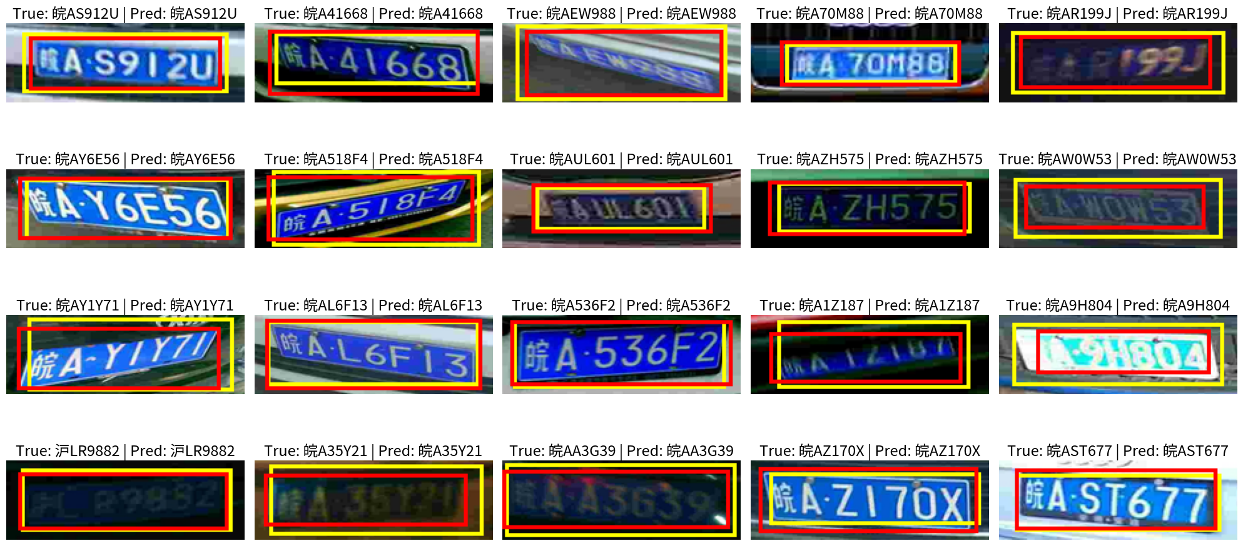
Results
True Bounding Box
Predicted Bounding Box
Car Plate Recognition and Reconstruction with DeepLearning

Slide 22
Conclusions
YOLOv5 + PDLPR achieves higher accuracy than baseline (89.5% vs 86.9%)
Biggest gains in difficult conditions
Baseline is faster (86 vs 66 FPS).
Trade-off between accuracy (YOLOv5+PDLPR) and speed (baseline).
Future improvements:
Training with more data (including synthetic samples)
Increasing training epochs
Using balanced data
Latest version of YOLO
Car Plate Recognition and Reconstruction with DeepLearning

